Slide 1


Slide 2
Lecture : 05
Introduction to CSS

Slide 3
What is CSS?
CSS stands for Cascading Style Sheets. It is used to design and style web pages created with HTML.
HTML creates the structure of a webpage (content).
CSS makes the webpage look beautiful (design and layout).
Example: <p>Hello Students</p>
With CSS: <p style="color:blue; font-size:20px;">Hello Students</p>
Now the text becomes blue and larger.
So CSS controls the appearance of a website.

Slide 4
Why css is important
CSS is used to:
Add colors to text and background
Change fonts and text size
Control spacing and alignment
Create layouts for webpages
Make websites responsive (mobile friendly)

Slide 5
Types of css
There are three ways to use CSS in HTML.
1. Inline CSS
Inline CSS is written inside the HTML tag using the style attribute.
<p style="color:red;">This is a red paragraph</p>
color changes the text color.
Inline CSS is useful for small changes, but it is not recommended for large websites.

Slide 6
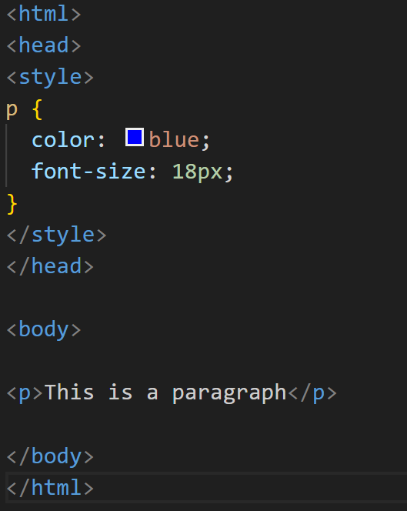
Cont…
2. Internal CSS
Internal CSS is written inside the <style> tag in the <head> section of HTML.
This will make all paragraphs blue.

Slide 7
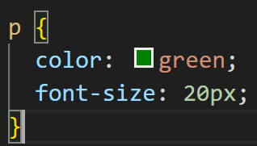
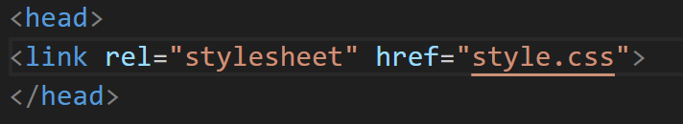
Cont…
3. External CSS (Most Recommended)
External CSS is written in a separate file.
Example file : style.css
Then connect it with HTML:

Slide 8
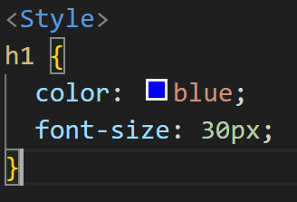
Css structure
CSS follows a simple structure.
Part | Meaning
h1 | Selector
color | Property
blue | Value

Slide 9
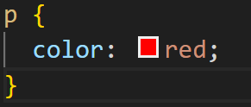
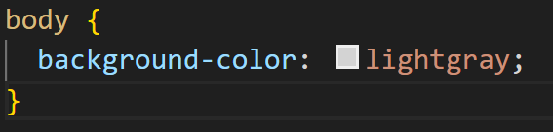
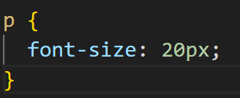
Common CSS Properties
1. Color
Changes text color.
2. Background Color
Changes background color.
3. Font Size
Changes text size.

Slide 10
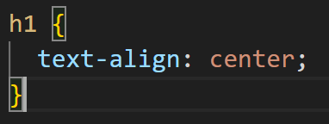
Cont…
4. Text Alignment
Aligns text.
Options include:
left
right
center

Slide 11
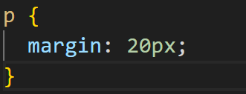
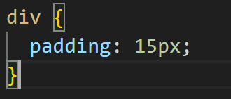
Cont…
5. Margin
Adds space outside an element.
Padding
Adds space inside an element.

Slide 12
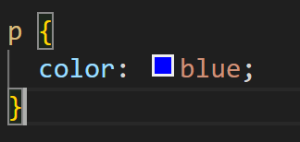
CSS Selectors
Selectors tell CSS which HTML element to style.
1. Element Selector
Applies style to all elements of that type.

Slide 13
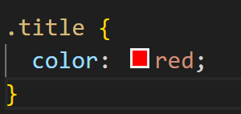

Cont…
2. Class Selector
Used for specific elements.
HTML:

Slide 14
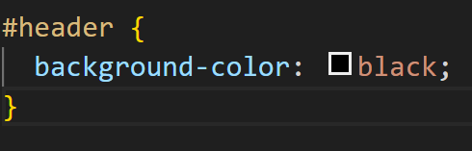

Cont…
3. ID Selector
Used for one unique element.
HTML:

Slide 15
boxes
In CSS, every HTML element is like a box. This is called the Box Model.
Box Model Components:
Content – The text or image inside the box.
Padding – Space inside the box, between content and border.
Border – The line surrounding the box.
Margin – Space outside the box, between other boxes.

Slide 16

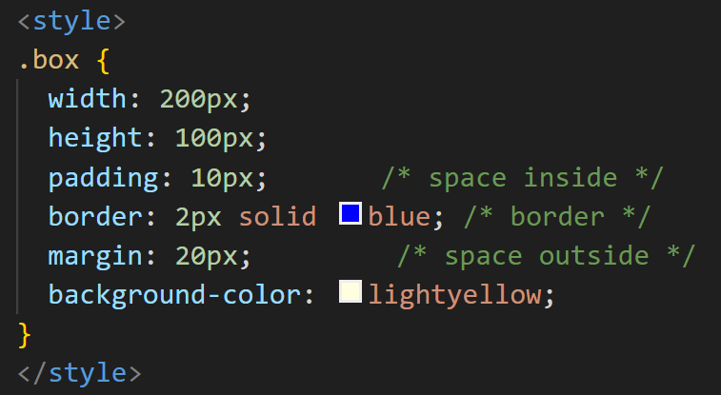
example
Output: A yellow rectangle with a blue border, some padding inside, and margin outside.

Slide 17
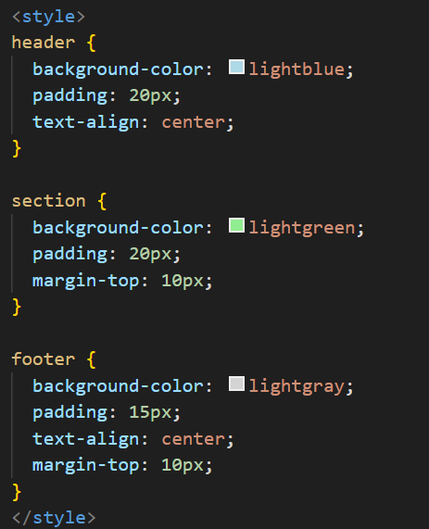
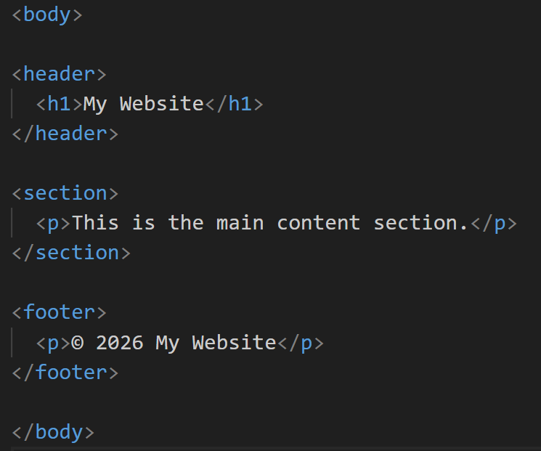
sections
Sections are different parts of a webpage like header, main content, sidebar, footer. You can use <div> or semantic tags (<header>, <section>, <footer>) to create sections.

Slide 18
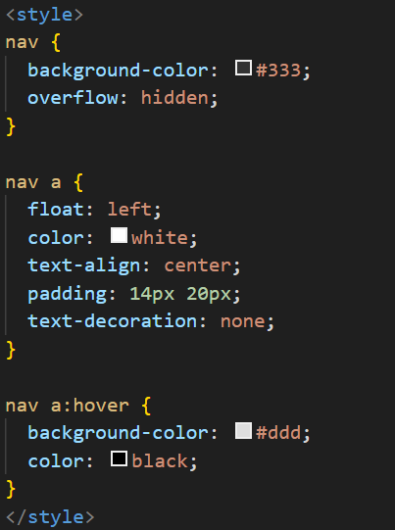
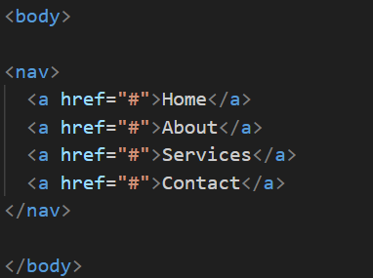
Navigation Bars
Navigation bars help users move between pages. You can create them with <ul> and <li> or <nav>.

Slide 19
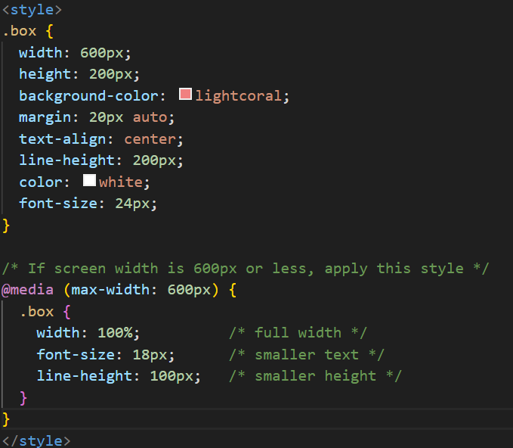
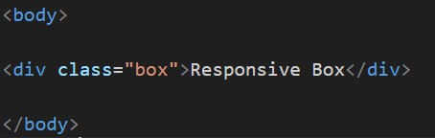
Introduction to Responsive Design
Responsive design makes your website look good on all devices (desktop, tablet, mobile).
The main tool is Media Queries in CSS.

